Slide 1


Using heat stress to mitigate physiological decline during long-term spaceflight
Chloe Gustafson
Dr. Travis Gibbons, Department of Biological Sciences, Northern Arizona University
Arizona Space Grant Consortium
April 19, 2025
Notes:
Hi everyone, my name is Chloe Gustafson and I attend Northern Arizona University. My mentor is Dr. Travis Gibbons.
This presentation shows the work I have done so far with the NASA Space Grant as well as what I hope to accomplish in the future.
The title of my project is “Using heat stress to mitigate physiological decline during long-term spaceflight”

Slide 2

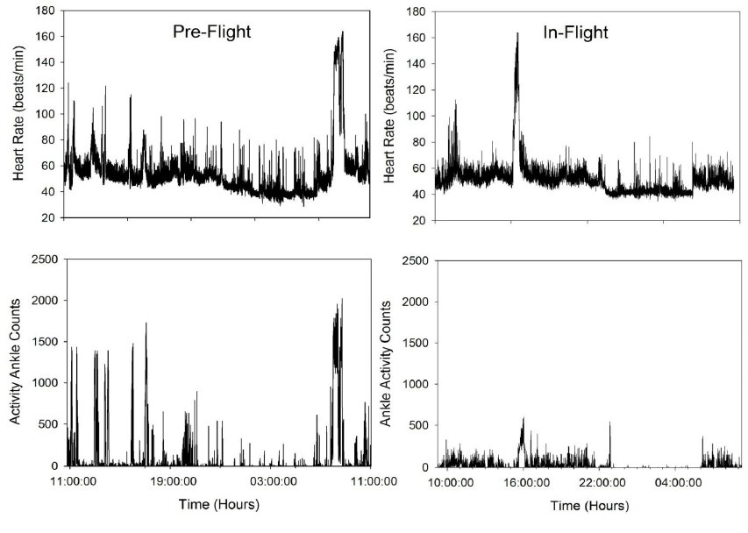
Background
Astronauts live free of the environmental and physical stress experienced on Earth
Exercise is required each day, yet astronauts experience rapid deterioration of some biological systems
2 hours of exercise may not be enough to overcome these negative effects
Notes:
Astronauts live free of the environmental and physical stress that is experienced on Earth. Such stress includes walking throughout the day and carrying one’s own bodyweight.
During space-flight, astronauts are already required to exercise for 2 hours each day, yet we still see rapid deterioration in some biological systems
This suggests that 2 hours of exercise cannot compensate for the lack of physical stress experienced in space.
For reference, these figures show a day trace of heart rate and activity counts pre and in-flight. This visualizes the activity difference seen on Earth vs. in space.

Slide 3
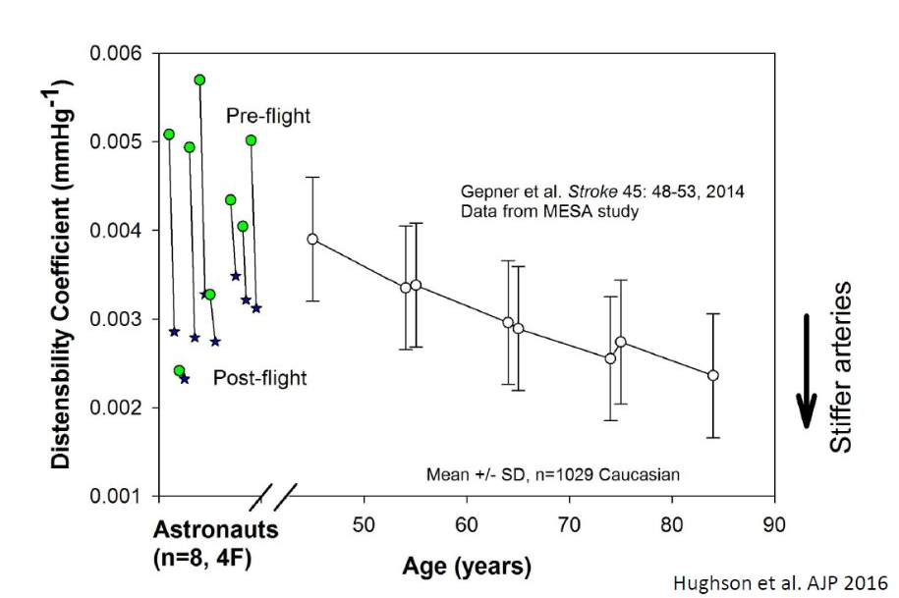
Background
Six months of spaceflight accelerates arterial aging by 30 years
Notes:
One of the physiological declines we see in astronauts is the stiffening of their arteries. As shown by this figure, the change in arterial stiffness in just 6 months of spaceflight is equivalent to arterial aging that occurs in 30 years on Earth.
Arterial stiffening is a precursor to cardiovascular disease which is why is it such a concern for returning astronauts.

Slide 4
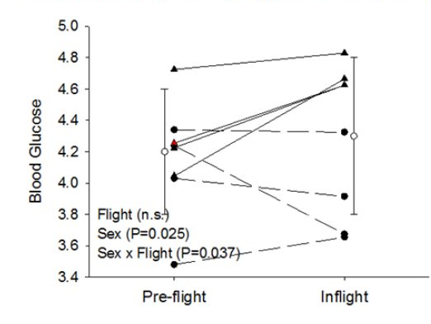

Background
Astronauts develop insulin resistance during spaceflight
Notes:
Another problem encountered during spaceflight is insulin resistance. This is when the body’s cells become less responsive to the hormone insulin.
This lack of responsiveness leads to higher blood glucose levels and increase the likelihood of pre-diabetes and type 2 diabetes.
These figures show that although blood glucose levels do not have a dramatic shift during spaceflight, insulin does, meaning individuals are more insulin resistant since more must be secreted to maintain proper blood glucose levels.
This is evidence that glucose control is impaired, however; a glucose tolerance test is needed to confirm this is due to insulin resistance.

Slide 5
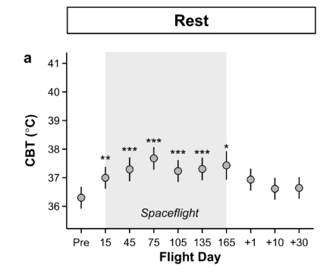
Background
During spaceflight, there is an upward shift in core temperature
Notes:
Another problem astronauts encounter is the upward shift of core temperature.
For reference average resting core temperature is around 37C. When a person approaches 40C, we begin to worry about heat induced problems such as heat stroke.
Even minor changes in core body temperature can impair both physical and cognitive impairment which is why it is important to find a strategy to regulate this factor.

Slide 6
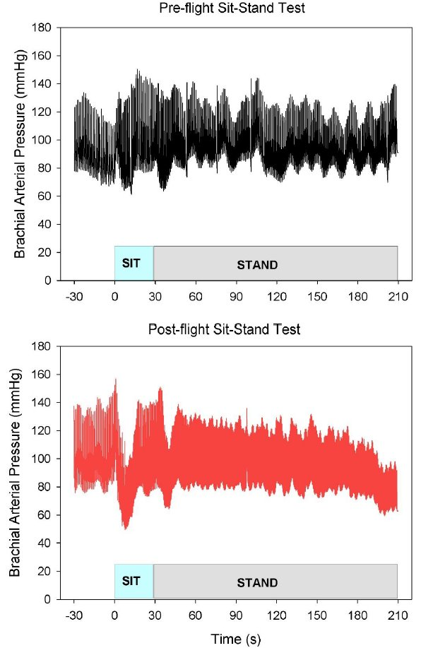
Background
Upon return to earth, astronauts struggle with blood pressure control, leading to light-headedness in the upright position
Caused by a decrease in blood volume
Notes:
Astronauts experience a decrease in total blood volume, specifically plasma volume during long-term spaceflight.
Upon return to Earth, this decrease in plasma volume leads to complications with maintaining blood pressure. This causes difficulty when being in the upright position.
This figure shows Brachial Arterial Pressure while sitting then standing. On Earth, there is a maintenance of blood pressure while standing, however; during spaceflight, we see a drop in blood pressure when standing.

Slide 7
Introduction
Acute heat exposure has short-term benefits for arterial function, insulin sensitivity, thermoregulation, and blood volume expansion on Earth
Therefore, we propose that the addition of heat stress to exercise during spaceflight will minimize these negative health outcomes in astronauts
Notes:
On Earth, heat exposure has been shown to provide short term benefits for arterial function and insulin sensitivity. Heat stress has also been shown to decrease core body temperature and expand plasma volume 24 hours later.
Because of this, we propose that the addition of heat stress to exercise during spaceflight will minimize the negative health outcomes that occur in astronauts.

Slide 8
Study Design
Repeated measures design
Each participant will complete every condition
Participant Criteria:
Young healthy individuals, ages 18-50
Regularly physically active
Females: VO₂ Max ≥ 25mL/kg/min
Males: VO₂ Max ≥ 35mL/kg/min
Notes:
This study is a repeated measures design, meaning each participant will complete every condition.
We recruit healthy young individuals ranging from ages 18-50. Participants must be regularly physically active and have no history of chronic illness. We assess if individuals are fit to participate by running them through a VO2MAX test. This test assesses their maximal aerobic power output, a direct indicator of cardiovascular fitness.

Slide 9
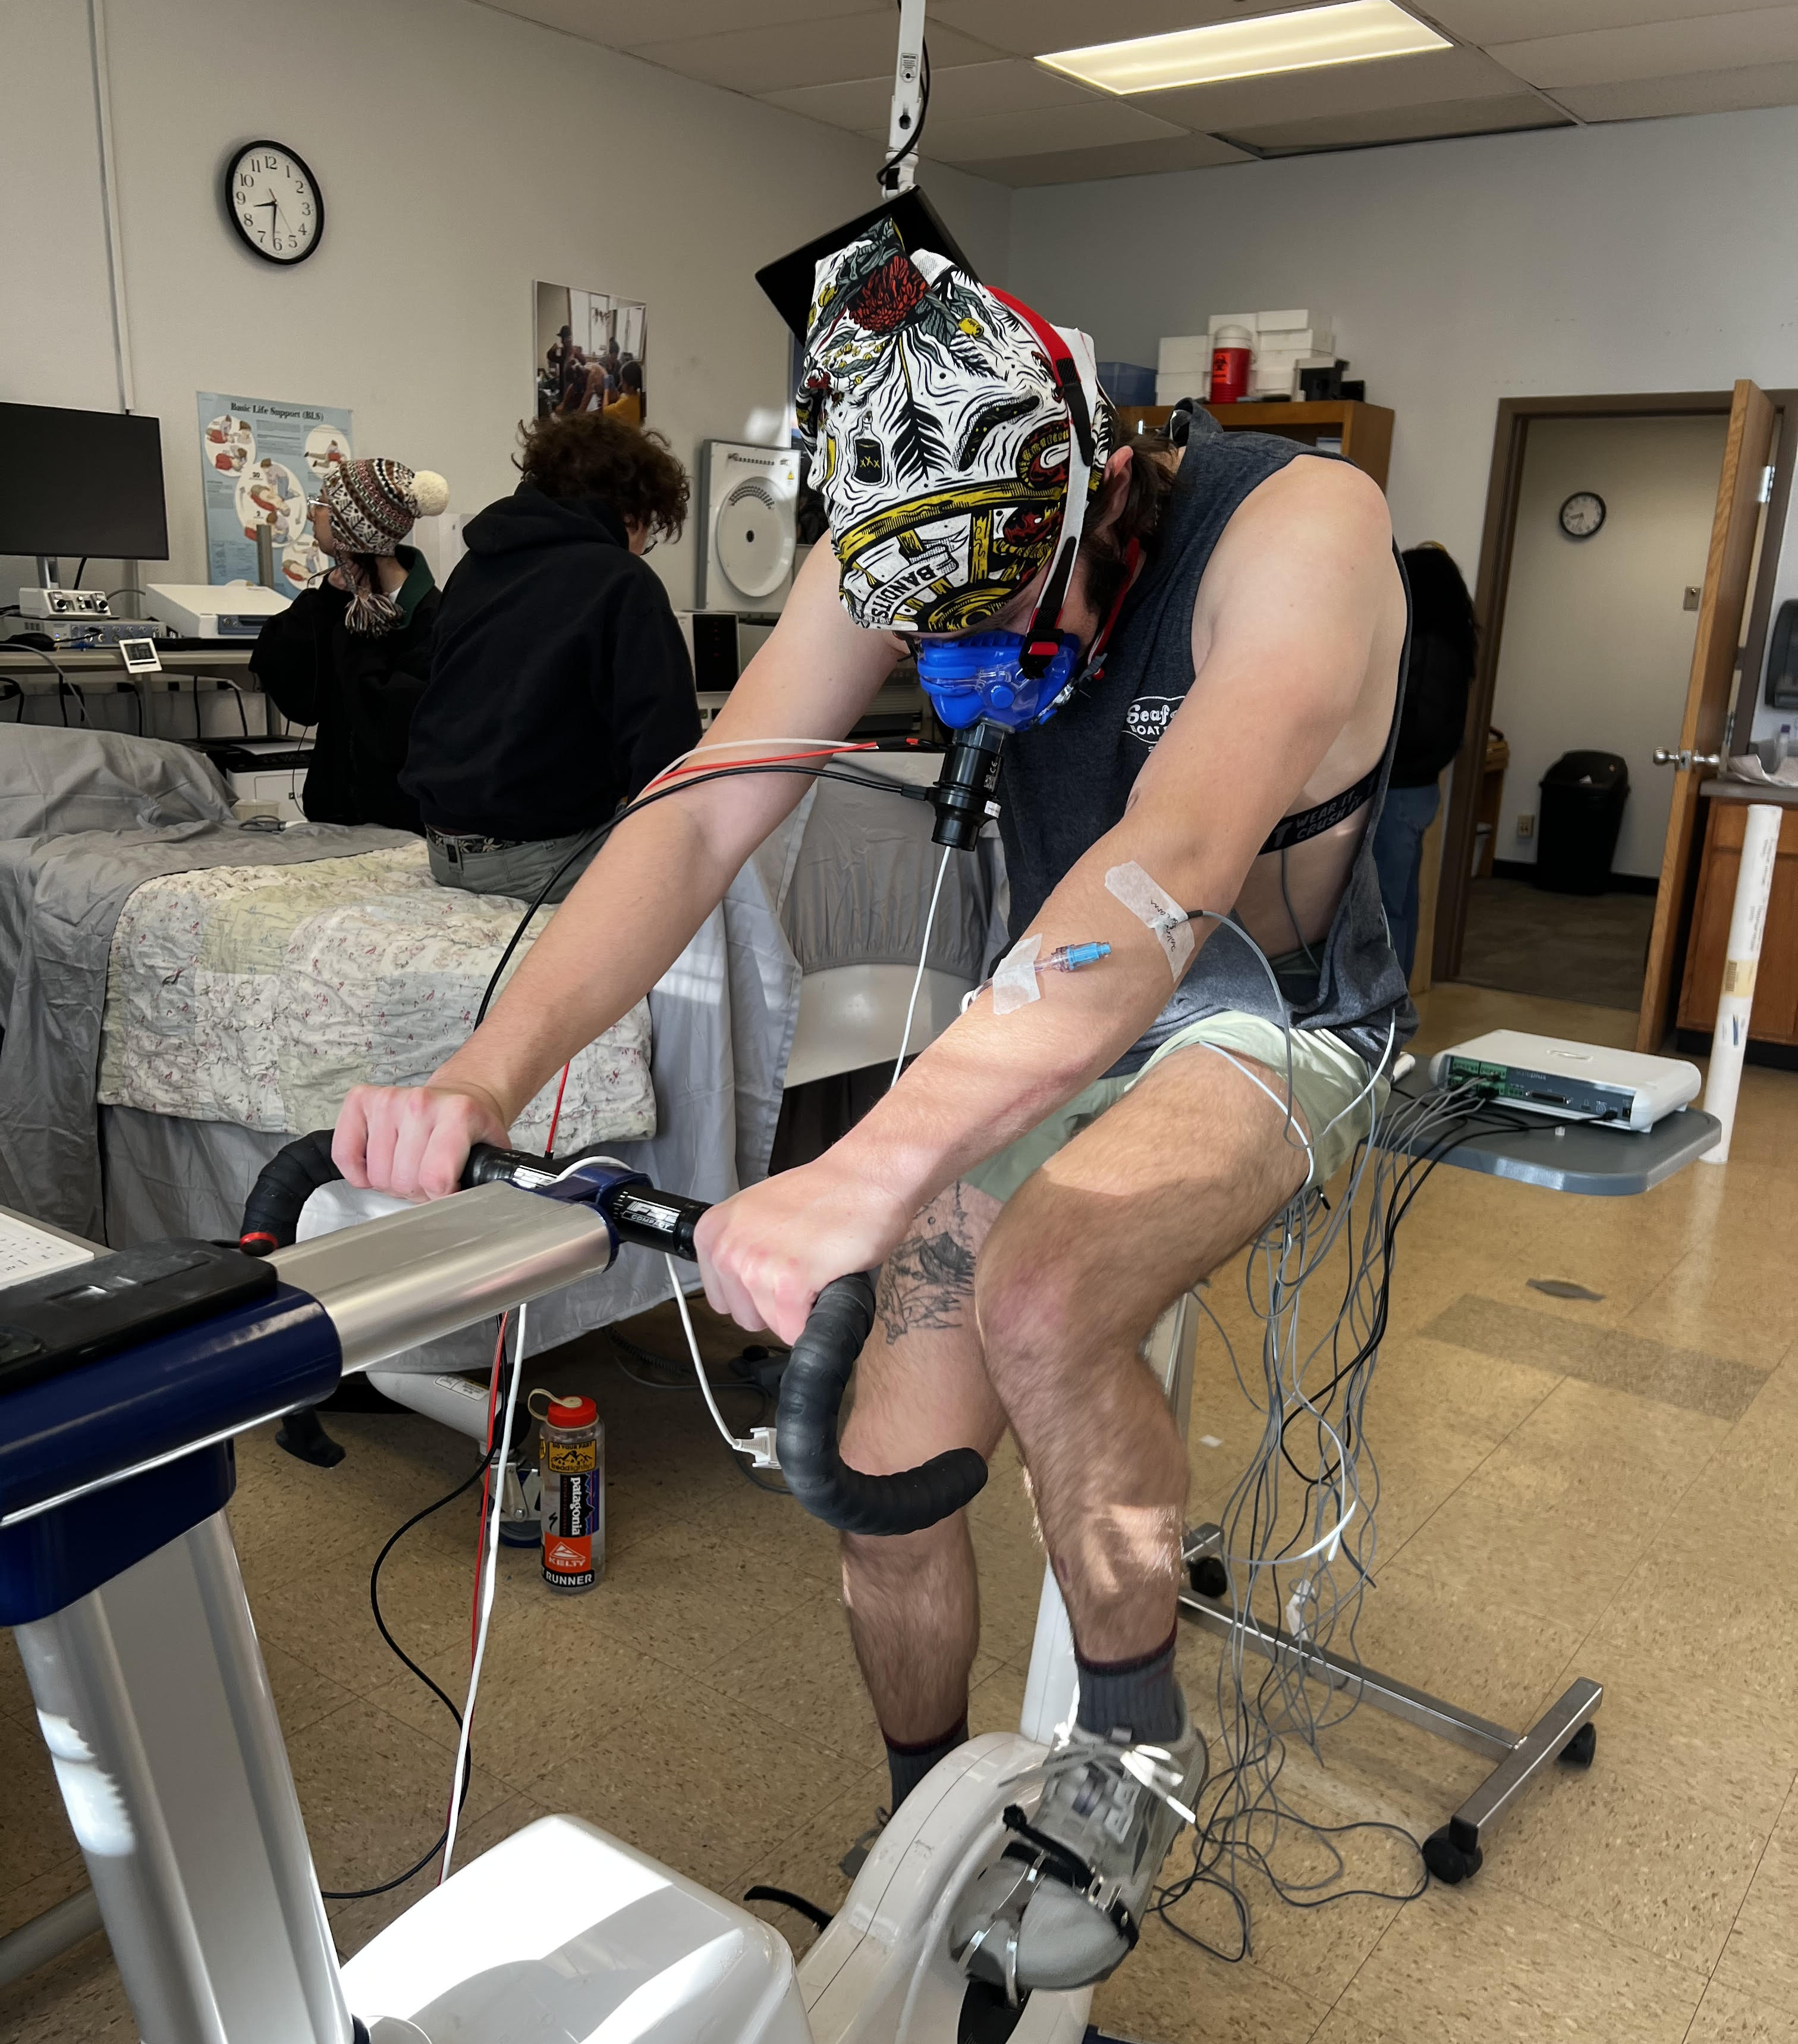
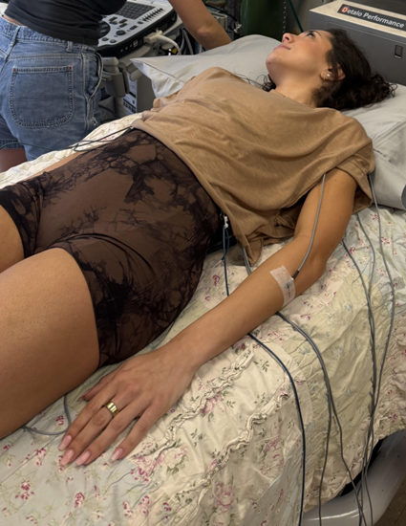
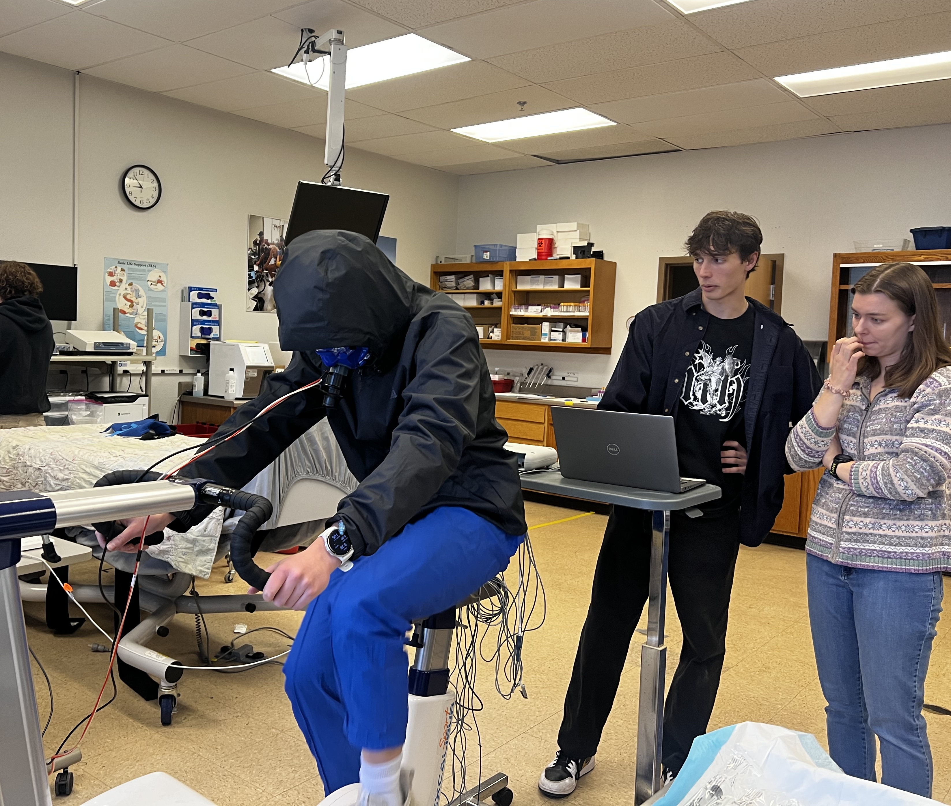
Methods
3 Experimental Conditions:
Cool Exercise (EXC)
Hot Exercise (EXH)
Control (CTRL)
Notes:
Each participant will complete 3 experimental day conditions. The first condition is the cool exercise condition.
This day varies from the other 2 as the participant cycles for 90 minutes at a set work rate, however; we are trying to keep them as cold as possible. This is done with the use of fans, icepacks, and by wearing minimal clothing.
The next condition is hot exercise. In the hot exercise condition, participants engage in 90 minutes of cycling at the same work rate as the cold condition, however; they must be wearing water impermeable clothing such as rain pants and a rain jacket. This allows our participants to have an increase in core temperature because sweat is unable to evaporate off the skin.
Finally, the control condition. During the control, participants relax on the bed for the 90 minutes they would otherwise be cycling for. The control day is important because it allows us to see if time, alone, changes any of our outcome measures.

Slide 10
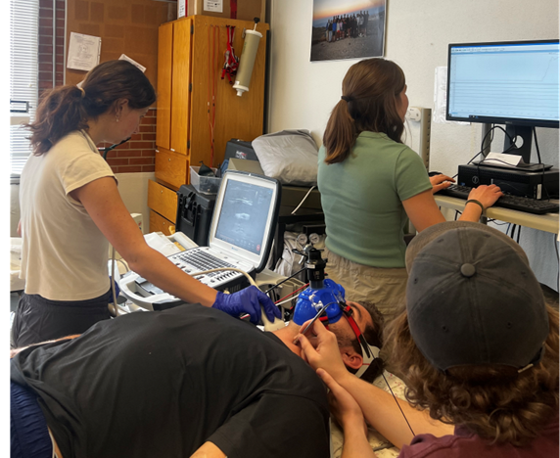
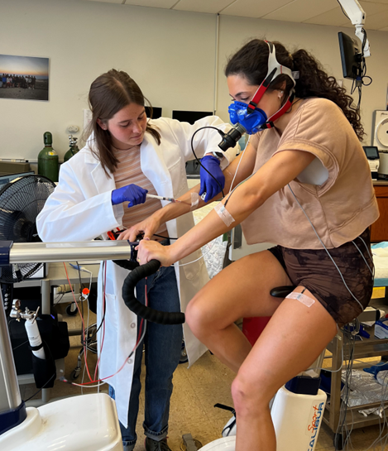
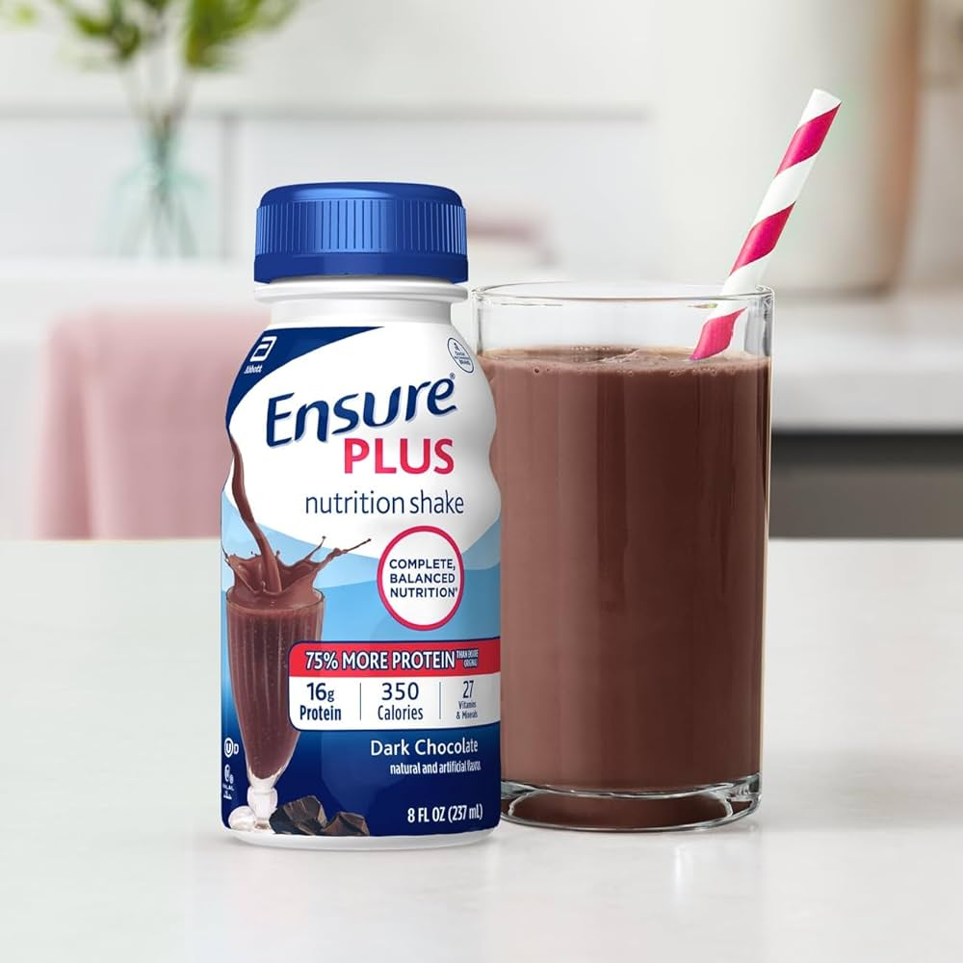
Methods
Experimental Day
Participant cycles for 90 minutes in cold or hot conditions, for the control, they rest for the 90-minute period
Participant consumes mixed-meal shake, blood is taken periodically for two hours to track glucose and insulin response
Venous catheter is placed, baseline measurements for blood, arterial compliance, and temperatures
Participant recovers for 2 hours, post measurements taken for arterial compliance
Start
End
Notes:
At the start of the protocol for each condition, we being by monitoring participants’ core temperature. A venous catheter is placed for each participant. We take baseline blood, arterial compliance, and temperature measurements.
Depending on the condition, participants either bike for 90 minutes in cold conditions, hot conditions, or remain laying on the bed for the time control. Following the 90 minutes, participants recover by laying for 2 hours until post measures are taken for arterial compliance.
We then begin a Glucose Tolerance Test by giving our participant a mixed meal shake. Blood samples are taken periodically to measure their glucose and insulin traces.

Slide 11
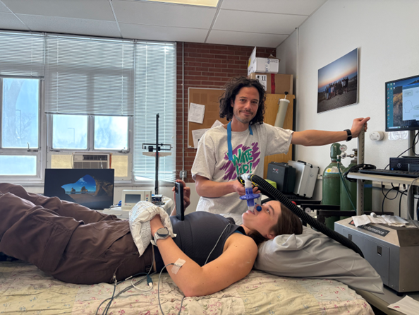
Methods
24 Hour Follow-up
The following day, participants complete a carbon monoxide rebreathe test
This method quantifies total blood volume and plasma volume (mL)
Participants are reattached to temperature probes to determine any acute responses in thermoregulation
Notes:
At the 24 hours follow up, participants are reattached to the temperature probes and core temperature monitor. We are interested in seeing any acute thermoregulation changes in response to the prior day.
Participants are guided through a carbon monoxide rebreathe test. With this method, we can quantify total blood volume and plasma volume in mL. This follow up is completed after each of the 3 conditions, allowing us to compare differences in blood volume.

Slide 12

Methods
Outcome Measures
Arterial compliance
The ability of the arteries to expand and contract in response to changes in blood pressure
Measured by carotid artery ultrasound, tonometry,
and repeated blood pressure readings
Heat stress will show acute improvements for arterial compliance
Notes:
The first outcome measure we are looking at is arterial compliance. This is a measure of arterial function based on the ability of the arteries to expand and contract in response to changes in blood pressure. We measure this through the use of carotid artery ultrasound, tonometry, and repeated blood pressure readings.
We expect to see an acute improvement in arterial compliance following the hot exercise condition.
Next, we are looking at insulin sensitivity. We measure this by having participants drink a mixed meal shake, and tracking their glucose and insulin response through periodic blood samples.
We expect to see an acute improvement in insulin sensitivity in the hot exercise condition.

Slide 13

Methods
Outcome Measures
Insulin Sensitivity
Measurement based on how well the cells respond to insulin
Glucose and Insulin response is measured
throughout a glucose tolerance test by analyzing
venous blood serums
Heat stress will show acute improvements for insulin sensitivity
Notes:
Next, we are looking at insulin sensitivity. We measure this by having participants drink a mixed meal shake, and tracking their glucose and insulin response through periodic blood samples.
We expect to see an acute improvement in insulin sensitivity in the hot exercise condition.

Slide 14
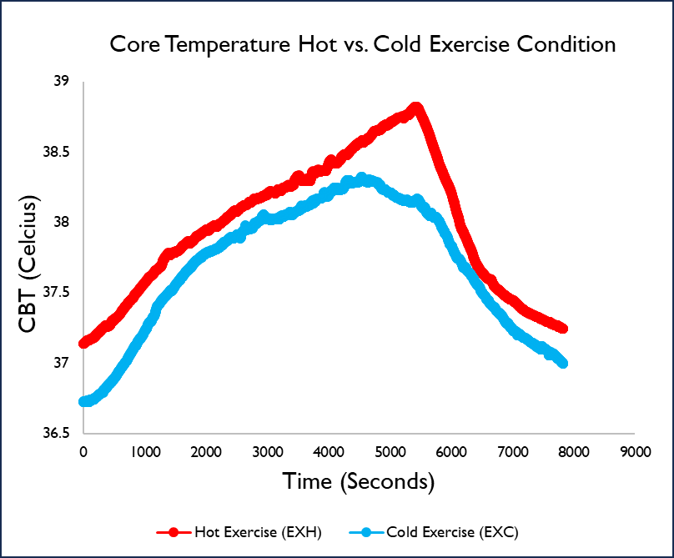
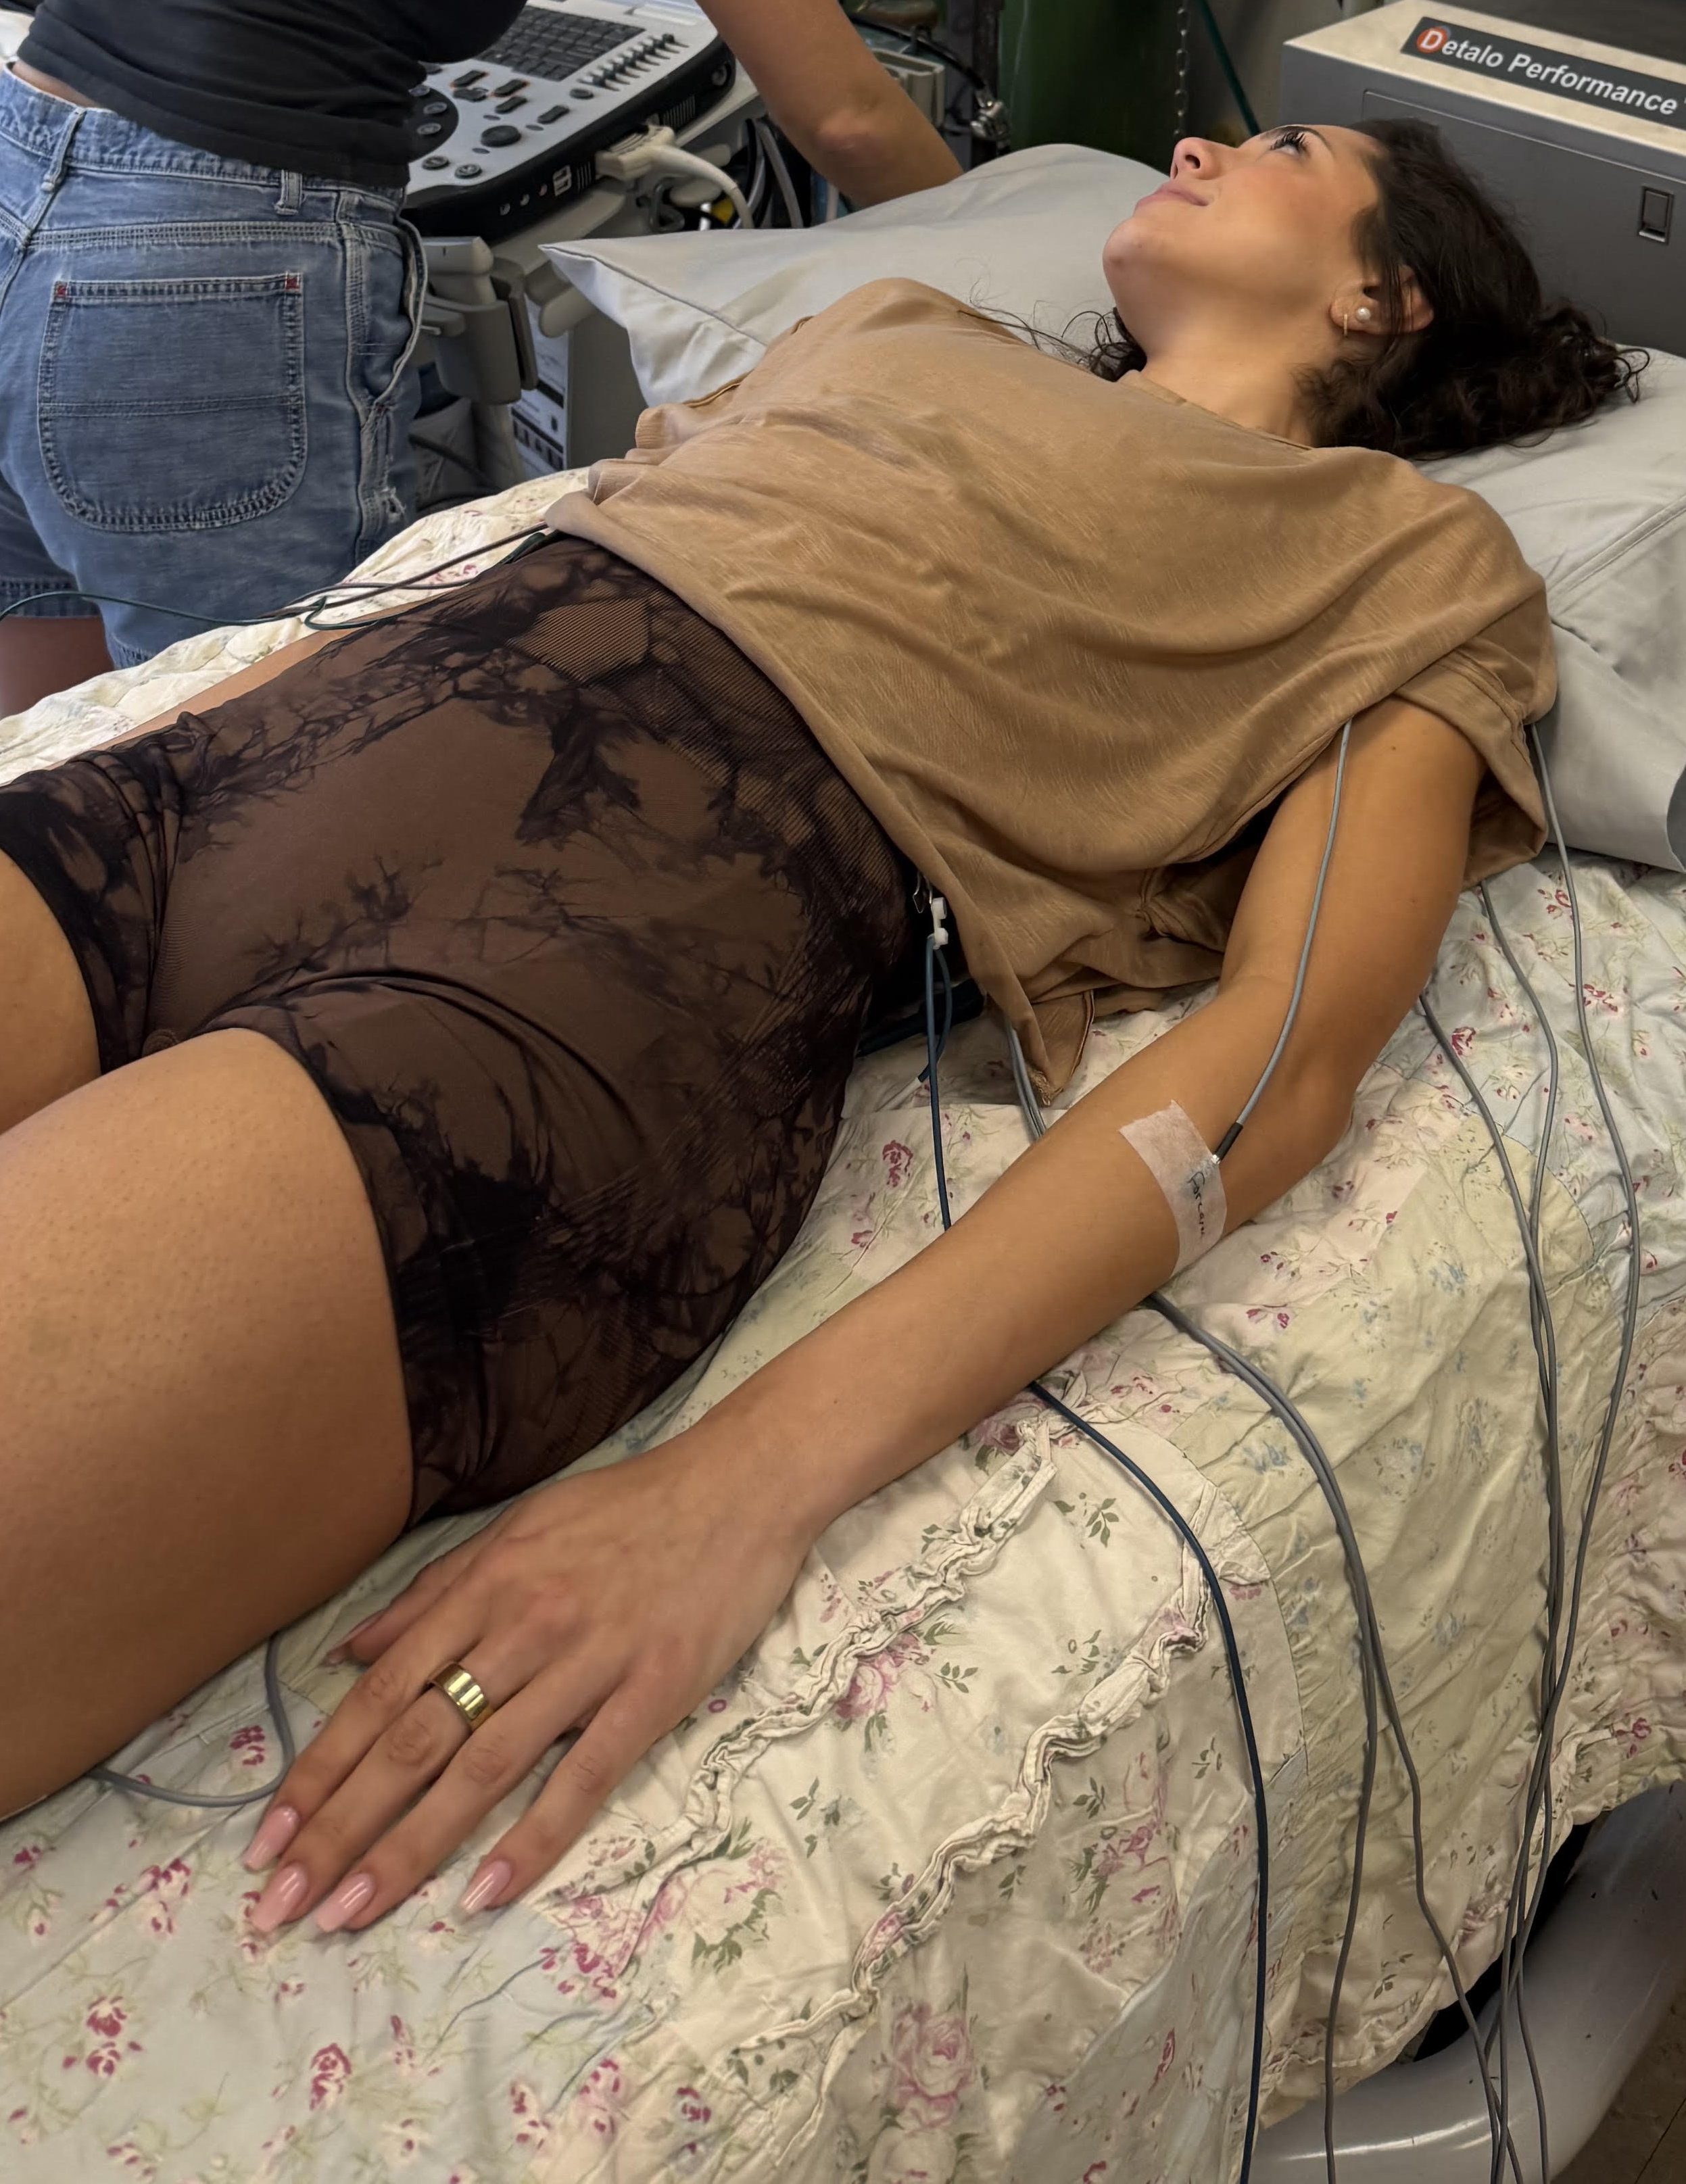
Methods
Outcome Measures
Thermoregulation
Participants resting core and skin temperatures are
monitored during each condition
Monitored for changes in core temperature 24 hours following each condition
Heat stress will decrease resting core body temperature 24 hours later
Notes:
We are interested in seeing how resting core temperature changes 24 hours after each condition. To determine this, participants are attached to temperature probes and a core temperature reader. This also allows us to ensure the difference in core temperature between the cold and hot exercise conditions is significantly different.
We expect to see a decrease in resting core body temperature 24 hours after the hot exercise condition.

Slide 15
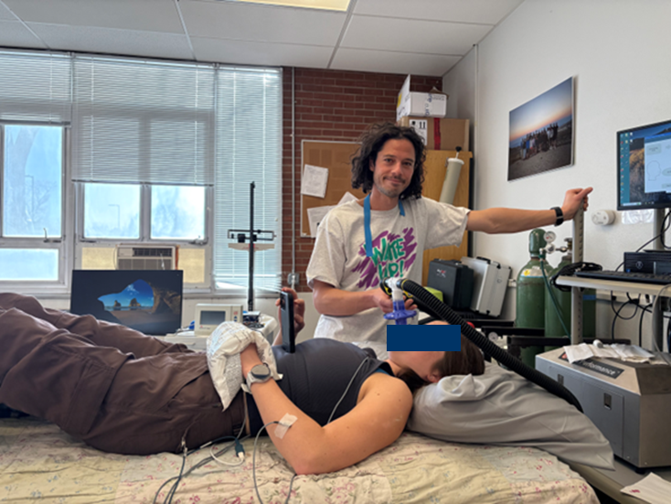
Methods
Outcome Measures
Blood volume expansion
Measured using carbon monoxide rebreathe
technique
Acute changes in plasma volume expansion
Heat stress will expand plasma volume 24 hours later
Notes:
Lastly, we are interested in blood volume expansion. By using a carbon monoxide rebreathe technique, we are able to compare differences in plasma volume between the 3 conditions.
We expect to see an acute expansion in plasma volume 24 hours after the exercise hot condition.

Slide 16

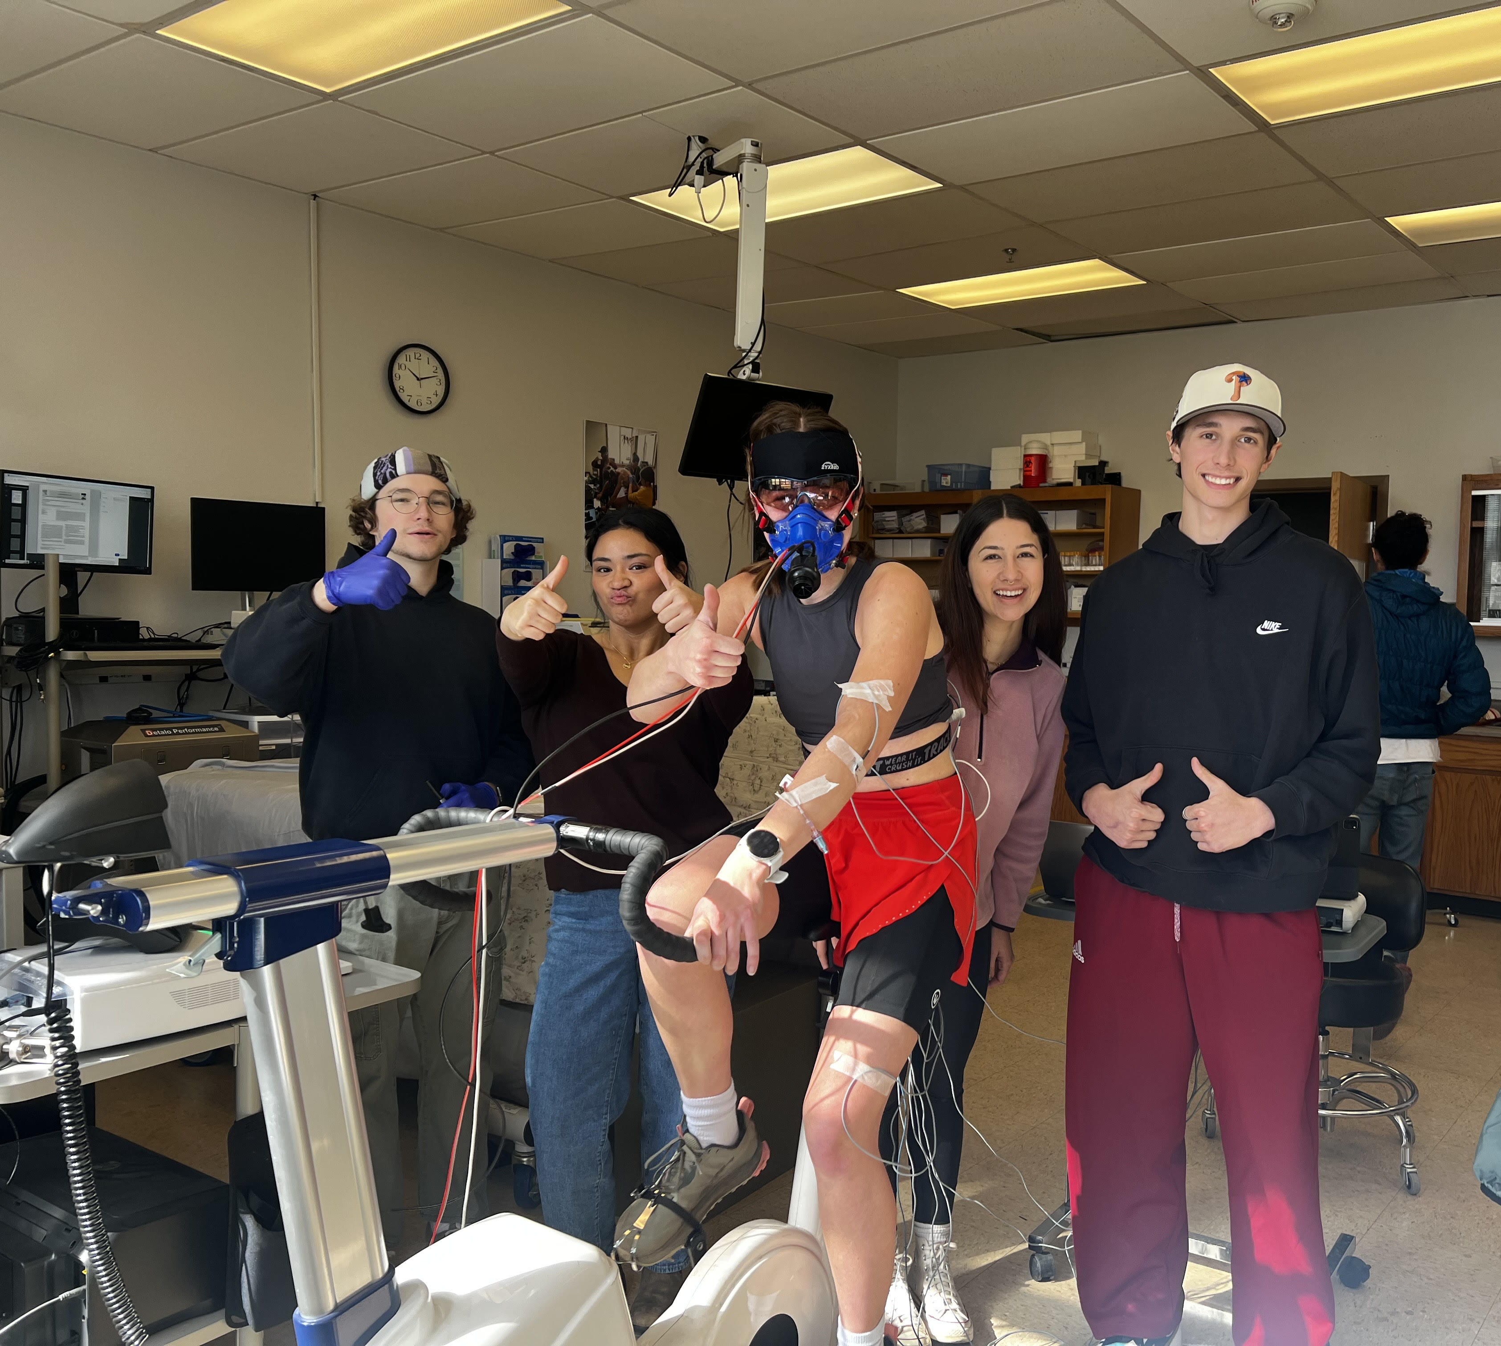
Acknowledgements
Everyone who participated
Jane Elliott, Andrew Weidner, Ellie Levi, Sarah Sheitelman, John Pederson, Tatum Kochanski, Jack Gibbons, Ruby Gustafson, and Daniel Buettner
NAU/NASA Space Grant
Notes:
These are my acknowledgements.

Slide 17
Thank you!
Any Questions?
Notes:
Thank you for listening, I am happy to answer any questions.

